Slide 1

An Introduction to Stocks
Spring 2007
© Jason Lee
Freshman Sophomore Business Club

Slide 2

Today’s Topics
What are stocks? What is the stock market?
  How do we make money off investing in stocks?
Why should I invest?
  Why stocks or mutual funds? Why not just save?
How should I invest?
  Understanding yourself to determine your financial goals
  Finding what you can do and what you want to do
Where do I start?
  What resources are out there? How can I learn more?
  How do I start investing?

Slide 3

Stock Basics
(What are stocks?)

Slide 4
What is a stock?
Common stock – most “common” type
Gives you a “share” of ownership of a publicly traded company
  Claim on its assets and earnings (dividends)
Also something called “preferred stock”
  Fixed dividend payments

Slide 5

What is a stock?
Ticker symbols
  Set of letters that represent a security traded on an exchange
  Ex. MSFT, GS, AAPL, MA, BUD, LUV
What are capital gains?
  Increase in value relative to the purchase price
  Not realized until asset is actually sold

Slide 6


The Markets
Exchanges
  Lists stocks and sets policies for how stocks are traded
  Major exchanges
    New York Stock Exchange (NYSE)
    American Stock Exchange (AMEX)
    NASDAQ

Slide 7
The Indices (index)
Imaginary collection of stocks that is supposed to represent the stock market
S&P 500
  (500 largest companies on US stock Market)
Dow Jones
  (30 most significant stocks in the stock market)
Nasdaq Composite
  (index representing all the stocks on the Nasdaq(tech))

Slide 8
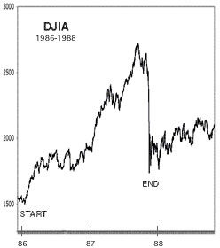
What Causes Stock Prices to Change?
Supply and Demand
Earnings (expectations)
Sentiments, attitudes, & sense of greed
Economic Indicators
Follow the leader
Manipulation
LOTS of different theories

Slide 9


Why invest? Why stocks?
(What about my savings account?)

Slide 10
What is this course about?
 | 1976-2000
Investment | Average Annual Return
S&P 500 |  | 11%
Small-Company Stocks |  | 12%
U.S. Treasury Bonds (short-term) |  | 4%
U.S. Treasury Bonds (long-term) |  | 5%
Savings Interest Rate |  | 1-3%
Inflation |  | 2-3%
Source: The Motley Fool Guide: How to Start Investing

Slide 11
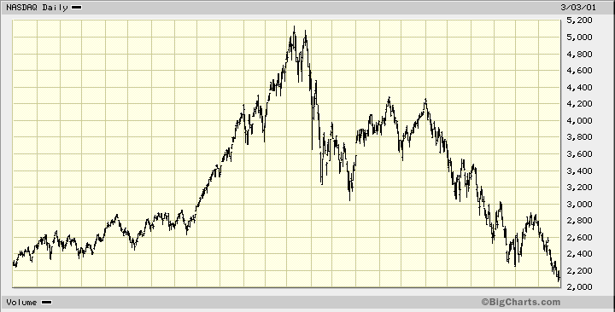
You can make good money…
(But don’t forget, you can lose a lot of it too)
NASDAQ (1999-2001)
+50% loss in 1 year
136% Gain in less than 1 year

Slide 12
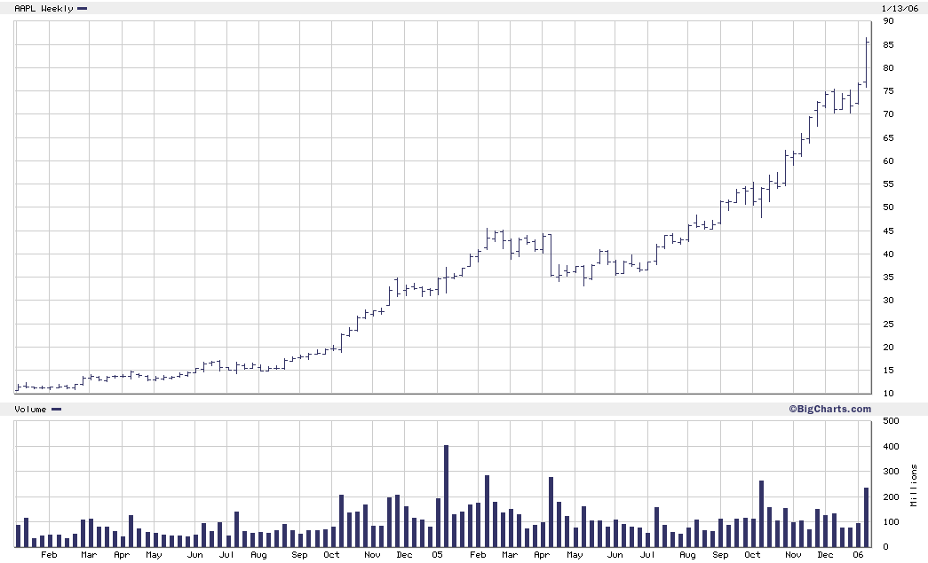
Apple Computers (+750% in 24 months)

Slide 13
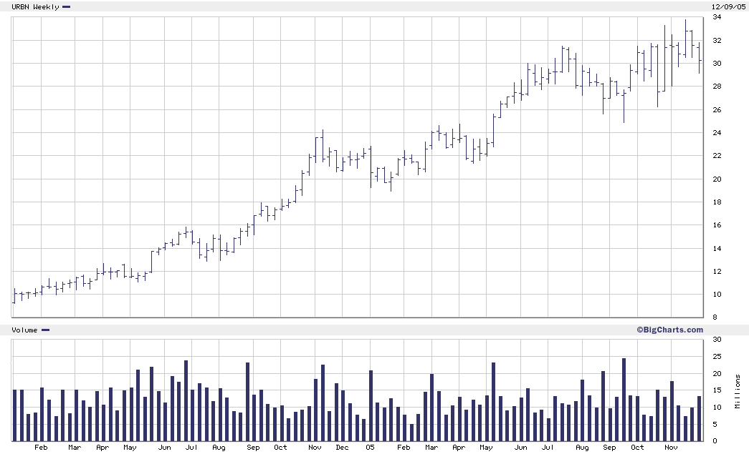
Urban Outfitters (+330% in 23 months)

Slide 14


How should I start investing?
(What kind of investor am I?)

Slide 15
Determining Your Financial Goals
Investing is a long car trip. There needs to be a lot of planning that goes into it.
  How much money do you want to make? By when?
  Will you need to live off your investments in future years?
  What will you be using your money for?
Having a good understanding of yourself will allow you to align your risk tolerance with various strategies
Think about your risk tolerance, time horizons for your investments, and your time commitment

Slide 16
The Risk / Return Tradeoff
“principle that potential return rises with an increase in risk”
  Low risk with lower returns, high risk with high returns
Important to know your personal risk tolerance when choosing investments
  Balance between risk and reward

Slide 17
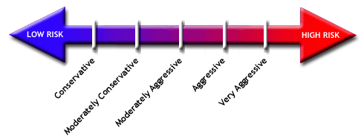
What is Your Risk Tolerance?
Source: Investopedia. “Determining Risk and The Risk Pyramid.” May 2 2003

Slide 18
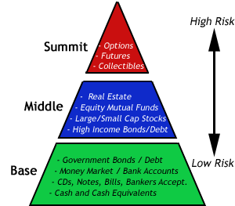
Source: Investopedia. “Determining Risk and The Risk Pyramid.” May 2 2003

Slide 19
Commitment and Interest
It all comes down to one question
  Do you want to actively choose or be a part of the decision to determine which companies to invest in?
  Do you want your investments to determined by some third-party?
Is it interesting to you? Can you commit the time and effort to keep up with the market news?

Slide 20
Active versus Passive Management
Active management
  Managing your own portfolio, determining which stocks to own and when to buy/sell
  Discussing with your broker what stocks you might want him to invest for you
  Choosing between different mutual funds
Passive management
  Choose one mutual fund and forgetting about it for the next 10 years
  Buying an index fund or having your portfolio match the index fund at all times

Slide 21


Where and how do I start?
(Starting an account, resources for learning)

Slide 22
Keep learning!
Make sure you understand the basics
  Investopedia (www.investopedia.com)
  Motley Fool (www.fool.com)
  Investor Guide (www.investorguide.com)
  These sites also have introductions to certain investing strategies
Books (learn from the greatest investors)
  How to Make Money in Stocks (William O’Neil)
  Beating the Street (Peter Lynch)
  Lessons from the Great Stock Traders of All Time (John Boik)
  The Warren Buffet Way (Robert Hagstrom)

Slide 23






Brokerages
Need a medium to trade through (brokerages)
Choosing a broker
  full service vs. discount
    Fees (Commission)
    Services
    Minimum balance
http://www.investingonline.org/gso/broker_ratings.html
http://www.consumersearch.com/www/internet/online-brokers/reviews.html
http://www.stockbrokerguide.com/

Slide 24
Mutual Funds
Funds in which investment professionals manage your money and decide on the investments
These funds often amount to millions and billions of dollars and come in a variety of types
Advantages
  Simplicity / Professional Management / Diversification / Liquidity / Usually Low Risk
Disadvantages
  Fees (and lots of them)

Slide 25
Opening an Account
Not a hard process- most of it just some paperwork and mail
  Sign-up online and download forms
  Mail checks, forms, and copy of ID
  Accounts created within a couple of days
Cash accounts usually never turned down
  Margin accounts might be a problem if you have pretty bad credit history
To start investing, won’t need much else other than a computer, some money, and investing know-how

Slide 26
Virtual Simulation
When you first start out, learn and try out your strategies on a virtual simulation
Allows to set up an imaginary account and trade virtual money on the real market with real-time updates
Thought not completely the same as real money, it will give you an idea of how the market works and how you will want to approach investing

Slide 27
Final Thoughts
Learn the basics!
  Can’t learn to run an offense without knowing how to bounce a ball and score
Figure out yourself and how you want to invest
  Have some specific financial goals and match that with a strategy
Keep learning and starting doing
  Best way to learn is to actually try investing

Slide 28

Questions & Answers

